Slide 1
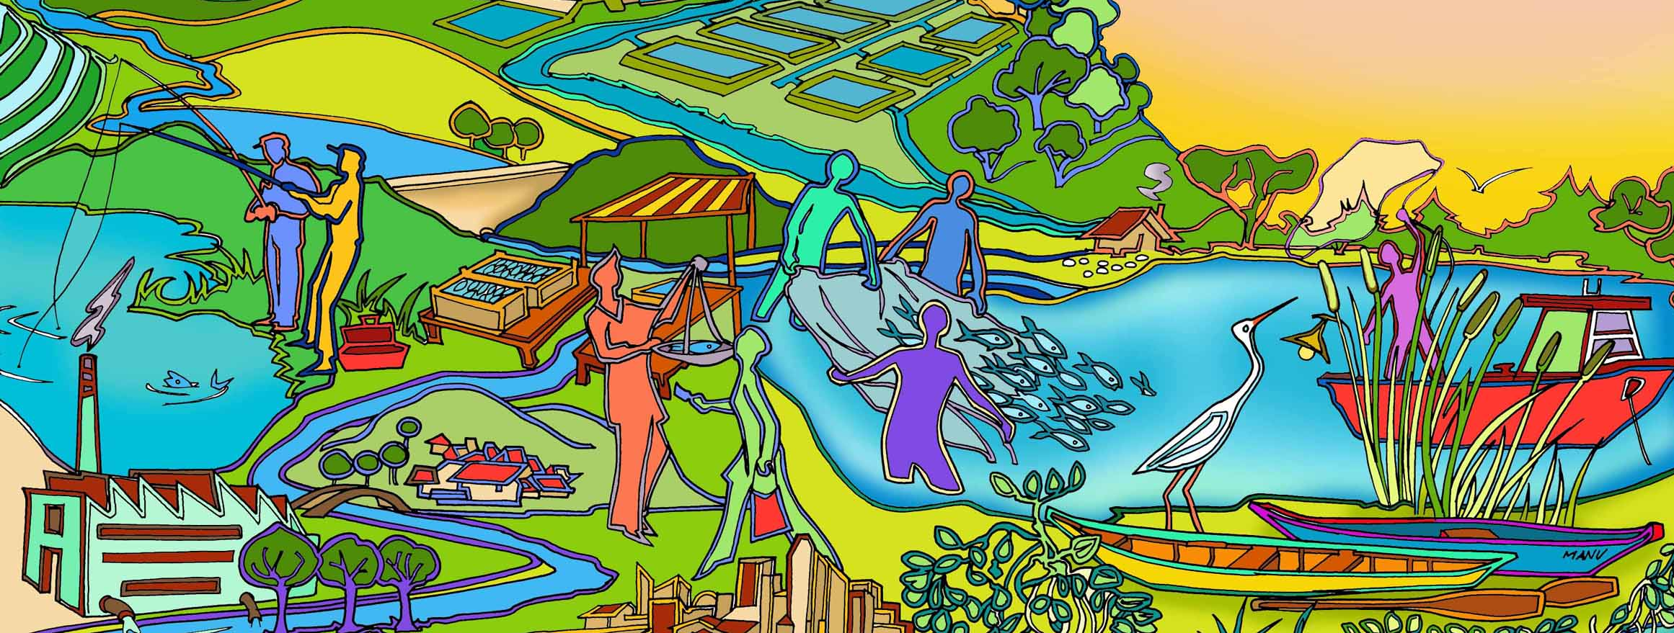
Session 8 EAFm Startup A: Preparing for EAFm
Essential EAFm training
Date |Place

Slide 2
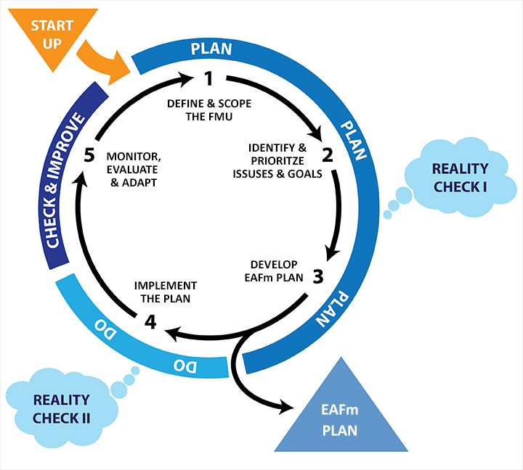
Notes:
We are now at the Startup stage – not yet entered the cycle.
Refer to large visual of this on wall (keep up as reference throughout course).

Slide 3
Session objectives
After this session you will be able to:
Define startup tasks needed to initiate the EAFm cycle and co-management
Learn how to identify and prioritize stakeholders
Notes:
Self explanatory.

Slide 4
To prepare there are 8 tasks that need to be done:
Form an EAFm team and facilitators
Identify the general location
Develop startup work plan
EAFm introduction
Coordination with other agencies and government levels
Identify and prioritize stakeholders and organizations
Establish a key stakeholder group
Determine legal basis for EAFm (check legislation for EAFm)
Notes:
In the Handbook, there are 8 tasks to be carried out in STARTUP A. However, in this session we will only focus on FIVE of them, shown here in red. These are:
Task 1 Form an EAFm team and facilitators
Task 2 Identify your broad geographic area and possible fishery to be managed
Task 3 Develop startup work plan
Task 6 Identify stakeholders and organizations; and
Task 8 Determine the legal basis for EAFm

Slide 5
EAFm Startup is a bit like baking a cake..
Startup tasks are used to prepare the ground to do EAFm, it is a bit like baking a cake:
Before baking a cake, the cook must decide:
Who will bake the cake (EAFm team)
What recipe will we use (startup work plan)
Where will the cake will be cooked (general location)
Who will eat the cake (stakeholders)
Who will oversee the cooking and distribution of the cake to others (key stakeholder group)
Notes:
This analogy helps us understand what Startup A is.

Slide 6
Identify the EAFm team and develop a startup work plan (Tasks i, ii and iii)
Establish a core team to guide the EAFm startup
ideally to include key agencies
identify a Team Leader to lead the process
Agree on what area the EAFm will focus on
The team develops a start-up work plan to guide the rest of the start-up tasks.
This identifies: what, how, who and when (and budget)
Notes:
This slide covers Task i to iii of the original list. The lead agency is often the Fishery Agency, for example an officer at the Provincial office. However, the lead agency could equally well be a NGO or a key stakeholder.
The core team act as steering committee:
Task ii is to agree on an area where the EAFm is to be developed
Task iii. The Startup work plan then identifies what tasks need to be carried out, and who will be responsible for theses. It also sets timelines and looks at the budget available to do the tasks.

Slide 7
Identify and prioritize stakeholders and organizations (Task vi)
Identify ALL stakeholders to begin with
Prioritize stakeholders
This is an initial identification of potential stakeholders and will be revisited
You will choose the EAFm key stakeholder group from this process
Notes:
This is task vi of the original list. At the beginning, it is important to include all potential stakeholders. Over time this number will reduce as trust is built up and various interest groups feel that they have been heard.
There are different methods for analysing stakeholders. Elicit from participants if they are familiar with any. After lunch we will do a matrix to analyse stakeholders, as well as a Venn Diagram (other examples of tools in People Toolkit).

Slide 8
Who are your stakeholders?
“A stakeholder is any individual, group or organisation who has an interest in or who can affect or is affected, positively or negatively, by the EAFm process”
Notes:
This definition of a stakeholder stresses that the individual, group or organisation should have an interest in the process and could affect, or be affected. Refer to same slide on wall as visuals gallery.
Debate definition. Stress that stakeholders must include all who affect, and all who are affected by EAFm objectives/ plans. Give examples of being negatively affected. For example, it may be necessary to reduce fishing in certain closed areas or seasons and this will have a short-term impact on income and livelihoods.
See next slide for examples of stakeholders.
Refer to Participant Handbook Module 8.

Slide 9
Possible stakeholders
Government
Fisheries
Environment
Advisors & Advocacy
NGOS,
Traditional leaders,
Researchers, Academics
Fishers
Fisher associations
EAFm
Other Users
Irrigation, Agriculture, Recreational fishing, Tourism, Conservation
Fisheries dependents
Boat owners, Processors, Traders, etc
MCS
Fishery patrol, Protection patrol
Notes:
This diagram includes fishers, governments, other fisheries stakeholders such as compliance & enforcement officers, shoreline communities and “advisors” such as NGOs, researchers etc.
Refer to Participant Handbook Module 8, Figure 8.2.

Slide 10
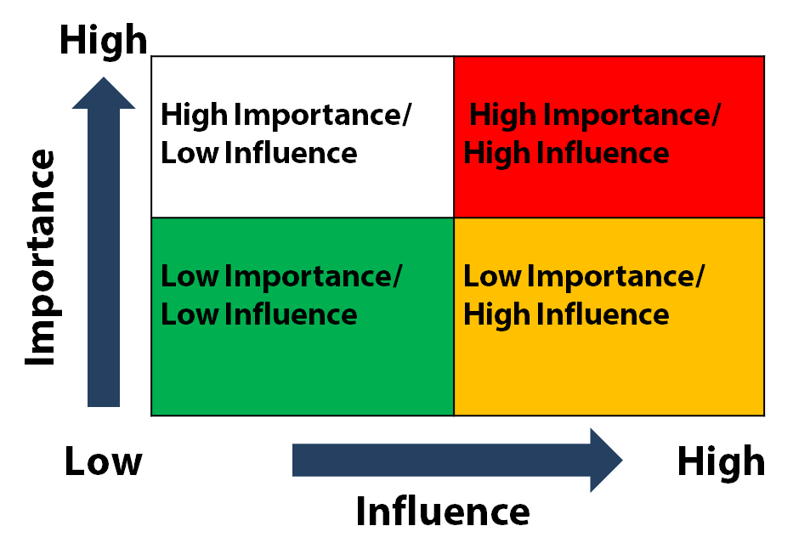
Stakeholder analysis
Importance: how important a stakeholder is for EAFm process
Influence: how much influence (power) a stakeholder has over EAFm process
2 x 2 matrix
Notes:
See details in Session Plan. Need to spend time explaining this as it is a group activity later.
This tool allows stakeholders to be categorised (by EAFM team) into four groups using two dimensions – influence & importance.
On the X axis we have the degree of influence a stakeholder will have i.e. how much power do they have to influence decisions? On the Y axis, we have the stakeholder’s importance i.e. how important is their influence?
In the right hand top box we have the stakeholders who have high importance and high influence.
This tool can be used more than once. It might be worth repeated once a Key Stakeholder Group has been formed (Task vii). It’s also good practice to do same exercise 1 year on and see if stakeholders have moved places (acts as a form of monitoring/ assessment).
Refer to Participant Handbook Module 8, Figure 8.3.

Slide 11
Prioritizing stakeholders
High Importance & Low Influence | High Importance & High Influence
Need to be represented | Key stakeholders for EAFm Need to be included in the key stakeholder group
Not likely to be interested | Need to get them to ‘buy in’ into EAFm process,’
Low Importance & Low Influence | Low Importance & High Influence
Notes:
Result:
This slide shows how to deal with those in each of red/ yellow/ green boxes.- i.e. develop strategies, monitor, etc.
See also same Figure 8.4 in Handbook.
Those in the red box are key stakeholders for EAFm success; you need to keep them motivated and on board, they are your ‘allies’. Keep communicating results to them. You don’t need to convince them of importance of EAFm- they already know. Those in green box are not interested and have little influence- keep them informed and involved, minimal effort, just monitor. Those in yellow boxes you must have strategies for. High influence + low importance: these ones you need to move along to the red box, you need to get them to ‘buy in’ into EAFm process, as they could be potential supporters and could use their influence to support EAFm process. However, some of these influential ones could also hinder/ block the EAFm process (political/ other gain…) so need to watch out for them. Those with high importance + low influence are often the most affected (i.e. have a high stake in the EAFm process) but do not have the power/ a voice. They need to be represented, be supported in having more of a say and influence over the EAFm process.
After groups have done their analysis reflect on how useful this tool is; what it can bring to light (depending again on who takes part) and what you can do about next steps.
Refer to Participant Handbook Module 8, Figure 8.4.

Slide 12
Activity: In your groups
List ALL possible FMU stakeholders. Write each stakeholder on a different card
Draw a 2 x 2 matrix with “Importance” on the Y axis and “Influence” on the X axis
Plot each stakeholder card onto one of the 4 boxes. You can move cards as you discuss
Based on how important each stakeholder is for the EAFm process and how much influence (power) each has over/in the EAFm process
Notes:
See Session Plan for details.
Use slide 10 notes to explain activity. Refer participants to Figure 8.3 in Participant Handbook.
Main point is the discussion that evolves as different participants’ views are expressed. Stakeholder cards will be moved, maybe new cards will be needed; there may be disagreement... All this ok.
Trainer: if participants can’t think beyond obvious stakeholders, refer to Checklist in Trainer Resource Guide, section 9 Selected resources, for more stakeholder categories.

Slide 13
Venn Diagram
Useful for describing relationships as part of institutional analysis
Dimension 1 = Size of circle (importance)
Dimension 2 = Proximity of circle (frequency of contact)
Separate circles = no contact
Touching circles = information passes between institutions
Small overlap = some cooperation in decision-making
Large overlap = considerable cooperation in decision-making
Notes:
We will now look at a tool to help analyzing linkages/ inter-relationships between organizations. Venn diagrams show the key institutions and individuals in a community, together with their relationships/ linkages and their importance in decision-making. Venn diagrams can help to identify potential conflicts between interest groups, and to clarify the roles of individuals and/or institutions.
This is a participatory tool so process as important as the end product. Refer to tool 5 in Technical Toolkit for explanation of how to use Venn diagrams.

Slide 14
Stakeholder Venn Diagram
INTERNATIONAL
FUNDING
HEALTH
UNIVERSITIES
HEALTH
AUTHORITY
COMMERCIAL FISHING COMPANIES
RESEARCH
LOCAL COMMUNITY
TOURISM OPERATORS
FISHER ASSOCIATIONS
AQUACULTURE OPERATORS
FISHERS
DEPT TOURISM PROMOTION
NGO/CSO
FISHERY DEPT.
INTERNATIONAL
FUNDING
FISHERIES
ENVIRONMENT DEPT.
INTERNATIONAL
FUNDING
ENVIRONMENT
ENVIRONMENT ORGANISATIONS
IRRIGATION DEPT
POLICE
VESSEL AUTHORITY
LOCAL PLANNING DEPT
INTERNATIONAL
FUNDING
AGRICULTURE
Notes:
Use this slide to explain how to do a Venn Diagram.
STRESS that this is just an initial analysis and may need to be revisited as the EAFm plan takes shape with its vision and goals.
1. Take the stakeholder group list (previous activity). 2. Write each stakeholder on a pre-cut circle of card ( decide if they are important (big circle) or not so important (smaller circle). This will be informed by the 2x2 matrix analysis 3. Identify the degree of contact and overlap between each circle in terms of decision-making. Overlap occurs if institution/stakeholder asks or tells another to do something or if they have to co-operate in some way.
Separate circles = no contact
Touching circles = information passes between institutions
Small overlap = some co-operation in decision-making
Large overlap = considerable co-operation in decision-making
It is best to do this with pre-cut circles on a flip chart sheet so stakeholders can be moved around as discussion progresses. If you draw with pen then difficult to erase/ change position. Stick circles onto sheet with sticky tack/ sellotape, so sheets can be displayed later on your EAFm teamwall if wanted.
Refer to Participant Handbook Module 8, Figure 8.5.

Slide 15
Activity: In your groups
Plot the fishery agency and other stakeholders using Venn diagram technique
Identify the interrelationships and linkages between agencies and institutions
What could strengthen linkages and coordination?
Notes:
See details in Session Plan.
Having explained how to do a Venn diagram, get groups to actually do one. Have slide 14 on the screen so they can refer to it. Also refer to Figure 8.5 in Participant Handbook.
N.B. Explain this is work in progress and can be added to later. At this stage of the process they are discussing the relative importance of the different stakeholders.
The importance of exercise is in the DISCUSSION (and eventual consensus of placing stakeholders) and in generating ideas for strengthening linkages between institutions. Ask groups to be creative in displaying the types of linkages (e.g. dotted lines, colours… each can represent something (ensure they have key on finished product).

Slide 16
Determine the legal basis for EAFm
It is desirable to have a legislative or policy mandate
especially for co-management so that local communities have legal authority
Lack of appropriate existing legislation should not be used as a reason to delay
Review the legal basis for EAFm
Notes:
It is desirable to have a legislative or policy mandate to undertake an EAFm. This is especially true when using co-management so that local communities have the legal authority to manage.
Although establishing a legal basis for an EAFm is desirable, the lack of appropriate existing legislation should not be used as a reason to delay starting the process. As a start you should at least review the legal basis for EAFm so that you understand the existing supporting or non-supportive policy.

Slide 17
Startup A: Overview
EAFm TEAM
START UP WORKPLAN
REVIEW OF EAFm SUPPORTING LAW AND POLICY
AGENCIES & INSTITUTIONS ENGAGED
KEY STAKEHOLDER GROUP
STAKEHOLDERS
BROAD AREA FMU
Notes:
Summary slide. This is a visual representation of the main elements you need in place to be able to start EAFm planning process.
Up the top of the diagram we have the EAFm Team who have (ii) defined the broad are of interest (iii) written a workplan (vi) identified stakeholders, (v) and formed a Key Stakeholder Group. Although not covered in this session, the EAFm Team would have done a legal/policy review and as part of the stakeholder identification, (v) coordinated with other agencies and government levels
The checklist on last page of Module 8 is more comprehensive.
Refer to Participant Handbook Module 8, Figure 8.6.

Slide 18
Key messages
Before starting on the EAFm cycle there is some initial tasks to be done by the EAFm team to:
Get organized; and
Initiate stakeholder engagement
Undertake a legal review
Notes:
Self explanatory

